Slide 1


MYSURU ROYAL INSTITUTE OF TECHNOLOGY (Affiliated to VTU, Belagavi, Approved by AICTE, New Delhi & Govt. of Karnataka) Lakshmipura Road, Off-Mysuru-Bengaluru Highway, Srirangapatna
DEPARTMENT OF COMPUTER SCIENCE AND ENGINEERING
Project Presentation on
A Data Analytics Approach to the Cybercrime Underground Economy
Using Naïve Bayes Model
By,
YASHAS P (4MU16CS081)
PRAJWAL H S (4MU16CS088)
SHIVA PRASAD (4MU16CS058)
MAHADEVU M V (4MU16CS030)
Under the Supervision Of
Dr. Harish Boraiah
Project Guide
Dept of CSE,MRIT
Internal Guide
Sowmya B
Professor
Dept of CSE, MRIT

Slide 2

Contents
Abstract
Introduction
Objective
Literature survey
Existing System and its Disadvantages.
Feasibility Study
Proposed System and Advantages.
Architecture
Software and Hardware Requirements
System Design and Implementation
Future Work
References
Conclusion

Slide 3

ABSTRACT
Despite the rapid escalation of cyber threats, there has still been little research into the foundations of the subject or methodologies and person who deals with cyber security.
Crime-as-a-Service (CaaS), a criminal business model that underpins the cybercrime underground.
Motivation to investigate the cybercrime underground economy by taking a data analytics approach from a design science perspective.
To investigate the cybercrime underground economy by analyzing a large dataset obtained from the online hacking community.
Provides useful practical insights to practitioners.
underground market-illegal services are provided to help underground buyers conduct cybercrimes
Thus, CaaS is referred to as a do-it-for-me service, unlike crimeware which is a do-it-yourself product.
Periodic monitoring and analysis of the content of cybercrime marketplaces could help predict future cyber threats.

Slide 4
INTRODUCTION
As the threat posed by massive cyberattacks (e.g., ransomware and distributed denial of service attacks (DDoS)) and cybercrimes has grown, individuals, organizations, and governments have struggled to find ways to defend against them.
In 2017, ransomware known as WannaCry was responsible for nearly 45,000 attacks in almost 100 countries . The explosive impact of cybercrime has put governments under pressure to increase their cybersecurity budgets.
United States President Barack Obama proposed spending over $19 billion on cybersecurity as part of his fiscal year 2017 budget, an increase of more than 35% since 2016.
The cybercrime underground has thus emerged as a new type of organization that both operates black markets and enables cybercrime conspiracies to flourish.
In contrast, cybercrime networks are lateral, diffuse, fluid, and evolving.
the threat posed by the rise of highly professional network-based cybercrime business models, such as Crimeware-as-a-Service (CaaS), remains mostly invisible to governments, organizations, and individuals.

Slide 5
OBJECTIVE
This project collects data from the largest hacking community they do not consider other hacking communities.
Future studies will therefore need to generalize our findings by investigating a wider range of hacking communities.
Second, this study has focused on the CaaS and crimeware available in the cybercrime underground, but much in-depth analysis remains to be done on the configurations of cybercrime networks.
MOTIVATION:
1) A data analysis framework for analyzing the cybercrime underground.
2) CaaS and crime ware definitions.
3) An associated classification model.
4) Develop an example application.
Provides useful practical insights to practitioners by suggesting guidelines as to how govt needs to prepare for the attacks by the cybercrime underground.

Slide 6
LITERATURE SURVEY
Cybercrime has undergone a revolutionary change, going from being product-oriented to service-oriented.
The cybercrime underground has a highly professional business model that supports its own underground economy.
Sood and Enbody have suggested that crimeware marketplaces have three key elements, namely actors (e.g., coders, operators, or buyers), value chains, and modes of operation.
In criminology, routine activity theory (RAT) is used to explain the causes of crime, both general criminal activity and cybercrime . According to this theory, three elements are necessary for crimes to be committed:
a likely offender- ” are motivated sellers and potential buyers in the underground market.”
a suitable target- ” are the targeted vulnerable organizations.”
absence of capable gaurdians against crime- ” is due to organizations failing to take preventive measures against cybercrime.“
Two types of product or service are available in the cybercrime underground.
The first can be either CaaS or crimeware that are related to attack strategy, for example, phishing, brute force, or DDoS attacks, or can be used for spamming or creating botnets, exploits, ransomware, rootkits, or Trojans.
The second type of product such as anti-virus programs. These are based on programs designed to evade anti-virus software to either cause mischief or be left behind for later activation. Examples include encryption and virtual private network (VPN) services, crypters, and proxies.

Slide 7
Existing System
Cybercrime has undergone a revolutionary change, going from being product-oriented to service-oriented .
The cybercrime underground has a highly professional business model that supports its own underground economy.This business model, known as CaaS, is “a business model.
CaaS is referred to as a do-it-for-me service, unlike crimeware which is a do-it-yourself products.
Consequently, the CaaS business model can involve the following roles:
writing a hacking program
performing an attack
commissioning an attack
providing an attack server (infrastructure) and
laundering the proceeds.
Sood and Enbody have suggested that crimeware marketplaces have three key elements, namely actors (e.g., coders, operators, or buyers), value chains, and modes of operation.
Periodic monitoring & analysis of the content of cybercrime marketplaces could help predict future cyber threats.

Slide 8
FEASIBILITY STUDY
The feasibility of the project is analyzed in this phase and business proposal is put forth with a very general plan for the project and some cost estimates.
For feasibility analysis, some understanding of the major requirements for the system is essential.
Three key considerations involved in the feasibility analysis are,
◻ ECONOMICAL FEASIBILITY
This study is carried out to check the economic impact that the system will have
on the organization.
◻ TECHNICAL FEASIBILITY
This study is carried out to check the technical feasibility, that is, the technical requirements of the system.
◻ SOCIAL FEASIBILITY
The aspect of study is to check the level of acceptance of the system by the user.
This includes the process of training the user to use the system efficiently.

Slide 9

Disadvantages
It is not secured process.
Over under traction is invents
Download files, time is invited
The cyber-crime differs from general crime in many ways.
A previous study proposed a data mining framework for crime, dividing crimes harmful to the general public into eight categories:
1.Traffic violations,
2. Sex Crime,
3. Theft,
4. Fraud,
5. Arson,
6.Gang/Drug Offenses,
7. Violent crime, 8.Cyber-crime.
Although this study explained how data mining techniques could be applied to crime analysis, it did not consider the specific features of cyber-crime

Slide 10

PROPOSED SYSTEM
The goal of our data analysis framework is to conduct a big-picture investigation of the cybercrime underground by covering all phases of data analysis from the beginning to the end.
This framework comprises four steps:
defining goals;
identifying sources;
selecting analytical methods; and
implementing an application.
Steps 1–4 all contain the RAT elements Because this study emphasizes the importance of RAT for analyzing the cybercrime underground, the proposed RAT-based definitions are critical to this framework.
A. Step 1: Defining Goals The first step is to identify the conceptual scope of the
analysis. Specifically, this step identifies the analysis context, namely the objectives and goals.
B. Step 2: Identifying Sources the second
step is to identify the data sources, based on the goals defined by Step 1.

Slide 11
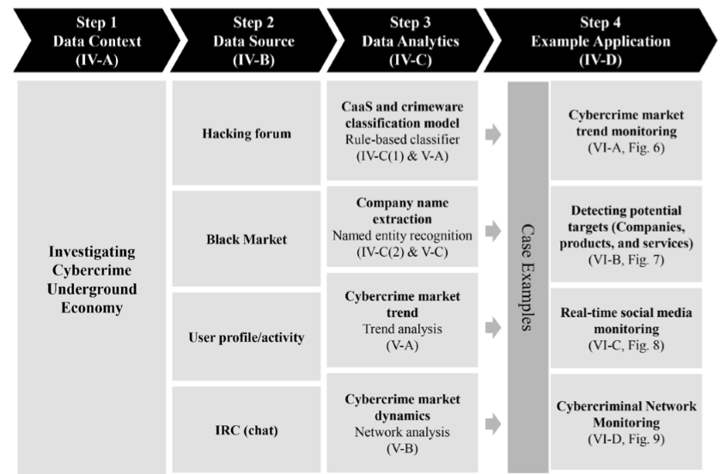
We collected a total of 2,672,091 posts selling CaaS or crimeware, made between August 2008 and October 2017.From a large hacking community site (www.hackforums.net) with over 578,000 members and more than 40 million posts.
We also collected 16,172 user profiles of sellers and potential buyers, based on their communication histories, as well as prices and questions and answers about the transactions.
The black market uses traditional forum threads (e.g., bulletin boards) instead of typical e-commerce platforms (e.g., eBay, and Amazon).
Since the product features, prices, and descriptions were explained within longer texts, we used a variety of text mining techniques to extract the important features.
In addition, we obtained a malware database from a cybersecurity firm containing over 53,815 entries covering cybercrimes between May 11, 2010 and January 13, 2014.
FIGURE 1. Proposed data analytical framework. Sections are in parentheses.

Slide 12
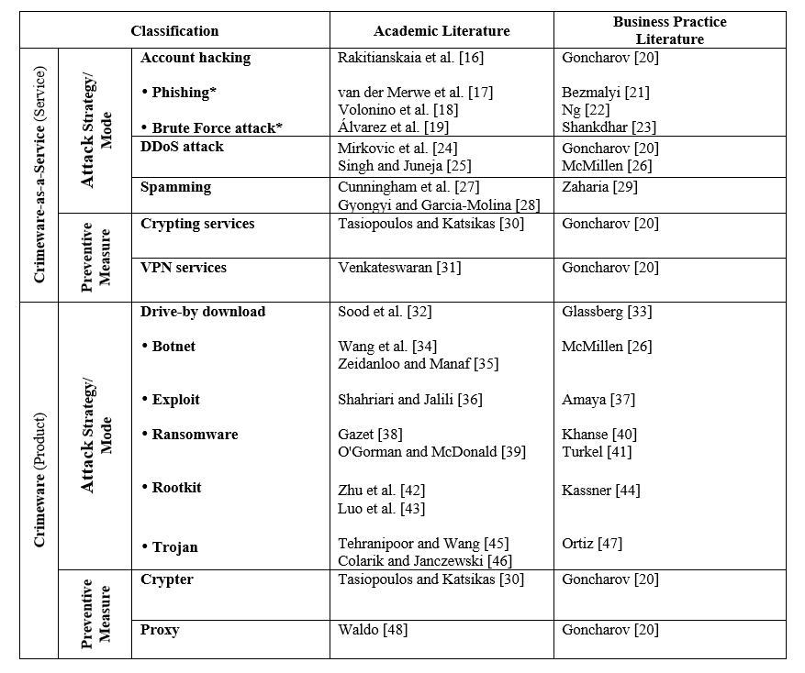
Classification of crimeware products and services. Phishing and brute force attack services are subsets of account hacking service.
Table 1 lists the definitions of CaaS and crimeware used in the academic and business practices literature, which form a basis for our classification model, suitable for the IS field. .
In contrast, preventive measures are associated with RAT’s absence of capable guardians because encryption and VPN services, crypters , and proxies are intended to neutralize preventive measures by bypassing anti-virus and log monitoring software.
TABLE 1. Classification of crimeware products and services. Phishing and brute force attack services are subsets of account hacking service.

Slide 13
Advantages
Compelling and relevant content will grab the attention of potential customers and increase brand visibility.
You can respond instantly to industry developments and be seen as ‘thought leader’ or expert in your field.
Positive feedback is public and can be persuasive to other potential customers.
Negative feedback highlights areas where you can improve.
The goal of the proposed framework is to “investigate the cybercrime underground economy.”
Data mining is a technique used to mine out patterns of useful data from large data sets.
This system will check the sender messages and whether the message is promoting terrorism.
Data mining as well as web mining are used together at times for efficient system development.
It will give more awareness to the users.

Slide 14
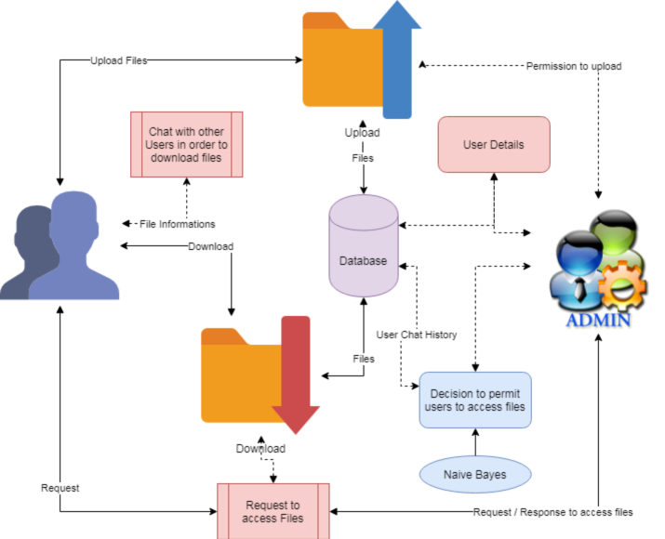
ARCHITECTURE
Figure : Architecture of Proposed Model

Slide 15

Explanation
Step 1:User Upload
Users upload their data through any media to the database.
Step 2:Admin process
Admin response for the request and process data
Step 3:Decisions to provide access
Using algorithms for decision making and provide access to requested customers.
Step 4:Download access files
Tracking of files and download the requested files.

Slide 16
Software and hardware requirements
Software Requirements:
Hardware Requirements:
Operating system :Windows 10 ,Linux
Coding Language : Python.
Front-End : Python.
Designing : Html , css , javascript
Data Base : MySQL.
System : Intel i3 2.4 GHz.
Hard Disk : Min 100 GB.
Monitor : 14’ Colour Monitor.
Mouse : Optical Mouse.
Ram : Min 2 GB

Slide 17
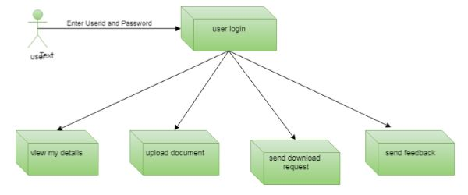
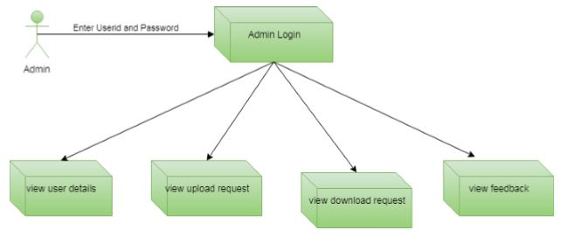
System design and implementation
DESIGN:
In contrast, the goal of our data analysis framework is to conduct a big-picture investigation of the cybercrime underground by covering all phases of data analysis from the beginning to the end (see Fig. 1). This framework comprises four steps: (1) defining goals; (2) identifying sources; (3) selecting analytical methods; and (4) implementing an application.
The data analysis step of the proposed framework involves four steps. Here, we report the data analysis results: CaaS and crimeware classification and market trends, cybercrime market dynamics, and potential hacking targets.
A.CaaS and Crimeware Classification and Market Trends .
B.Cybercrime Market Dynamics

Slide 18
Implementation
First, by creating example front-end applications, we have demonstrated how our design artifacts (the proposed framework and classification model) can be implemented in practice. Despite the rapidly growing threat from cybercrime, there has been little research into .practical frameworks for future cybersecurity researchers.
Second, this study adds to the emerging cybersecurity literature by providing a foundation on which to build [7]. We have investigated the cybercrime underground economy using our proposed analytical framework. Despite the importance of data analysis, scholars have had little guidance as to how to analyze and integrate data from different contexts.
Third, this study adds to the body of knowledge by demonstrating new approaches to the problems cybercrime and social media researchers. Despite the increasing importance of data analysis, researchers have been slow to recognize the advantages of new and more powerful data-driven analysis methods.
We have applied several modern techniques, such as machine learning, key phrase extraction, and natural language processing, in this area, thereby encouraging future research to be more systematic and empirical.
Finally, this study adds to RAT by applying it to the cybercrime underground. The same three factors can be applied to cybercrime and general crimes, so we have classified CaaS and crimeware in the context of the cybercrime underground and analyzed them accordingly

Slide 19
Algorithm:
Naive Bayes Classifier :
Naive Bayes is a classification algorithm for binary (two-class) and multi-class classification problems. The technique is easiest to understand when described using binary or categorical input values.It is called naive Bayes or idiot Bayes because the calculation of the probabilities for each hypothesis is simplified to make their calculation tractable.
Rather than attempting to calculate the values of each attribute value P(d1, d2, d3|h), they are assumed to be conditionally independent given the target value and calculated as P(d1|h) * P(d2|H) and so on.
Make Predictions with a Naive Bayes Model
Given a naive Bayes model, you can make predictions for new data using Bayes theorem.
MAP (h) = max(P(d|h) * P(h))
Using our example above, if we had a new instance with the weather of sunny, we can calculate:
go-out=P(weather=sunny|class=go-out)*P(class=go-out)stay-home = P(weather=sunny|class=stay-home) * P(class=stay-home)
We can choose the class that has the largest calculated value. We can turn these values into probabilities by normalizing them as follows:
P(go-out|weather=sunny) = go-out / (go-out + stay-home) P(stay-home|weather=sunny) = stay-home / (go-out + stay-home)

Slide 20



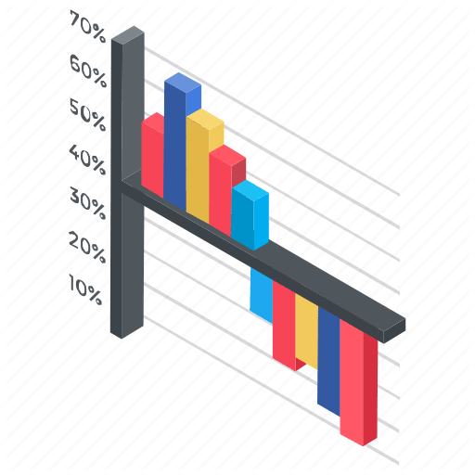
Modules included:
There are 4 modules used for this project they are listed below:
1.Upload Files.
2.Conversation Monitoring.
3.Download Files.
4.Graphical Representations.

Slide 21
FUTURE WORK:
Although our study has made several significant findings, it nevertheless has several limitations that will need to be addressed in future studies.
First, we only collected data from the largest hacking community and did not consider other hacking communities.
Second, this study has focused on the CaaS and crimeware available in the cybercrime underground, but much in-depth analysis remains to be done on the configurations of cybercrime networks.

Slide 22
conclusion
Because this study takes a DSR approach, we have focused mainly on building and evaluating artifacts rather than on developing and justifying theory: actions are usually considered to be the main focus of behavioral science.
We have therefore proposed two artifacts:
A data analysis framework and a classification model. We have also conducted an ex-ante evaluation of our classification model’s accuracy and an ex-post evaluation of its implementation using example applications. In line with the initiation perspective of DSR, these four example applications demonstrate the range of potential practical applications available to future researchers and practitioners.
Unlike previous studies that have presented general discussions of a broad range of cybercrime; our study has focused primarily on CaaS and crime ware from an RAT perspective. We have also proposed sets of definitions for different types of CaaS (phishing, brute force attack, DDoS attack, and spamming, crypting, and VPN services) and crime ware (drive-by download, botnets, exploits, ransomware, rootkits, Trojans, crypters, and proxies) based on definitions taken from both the academic and business practice literature.
Based on these, we have built an RAT-based classification model. This study emphasizes the importance of RAT for investigating the cybercrime underground, so these RAT-based definitions are critically important parts of our framework. In addition, unlike prior research that discussed the cybercrime underground economy without attempting to analyze the data, we have analyzed large-scale datasets obtained from the underground community.

Slide 23
References:
[1] J. C. Wong and O. Solon. (2017, May 12). Massive ransomware cyber-attack hits nearly 100 countries around the world. [Online]. Available:
V. G. Tasiopoulos and S. K. Katsikas, “Bypassing Antivirus Detection with Encryption,” in Proc., 18th Panhellenic Conf. on Informatics - PCI '14, New York, New York, USA, 2014, pp. 1–2: ACM Press
S. Gregor, “Design theory in information systems,” Aust. J. Inf. Syst., vol. 10, no. 1, pp. 14–22, 2002.
P. Shankdhar. (2017, May 29). Popular Tools for Brute-force Attacks. [Online]. Available: http://resources.infosecinstitute.com/populartools-for-brute-force-attacks
H. W. Kim, H. C. Chan, and S. Gupta, “Social Media for Business and Society,” Asia Pacific Journal of Information Systems, vol. 25, no. 2, 211-233, 2015
R. Baskerville, A. Ga, J. Pries-heje, and J. Venable, “Soft Design Science Methodology,” in Proc., 4th Int. Conf. on design science research in information systems and technology, 2009.

Slide 24

Thank you

